Slide 1













CHAPTER 4
C’MON, GUYS!

Slide 2
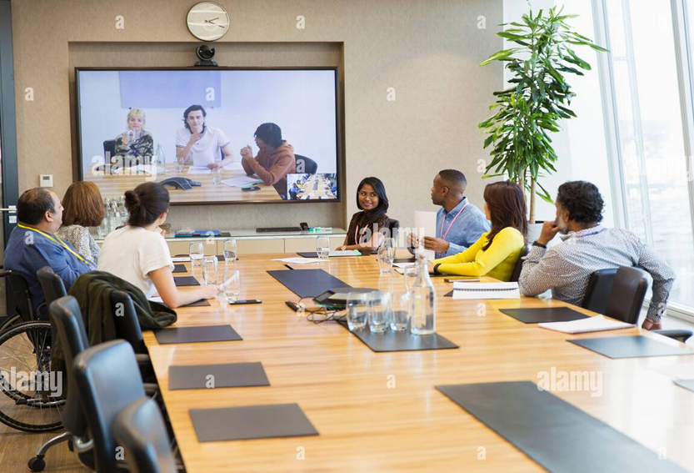
In what situations do people make request and ask for permission?

Slide 3
MAKING REQUEST AND ASKING FOR PERMISSION

Slide 4

What specific language do you use when you make request or ask for permission?

Slide 5
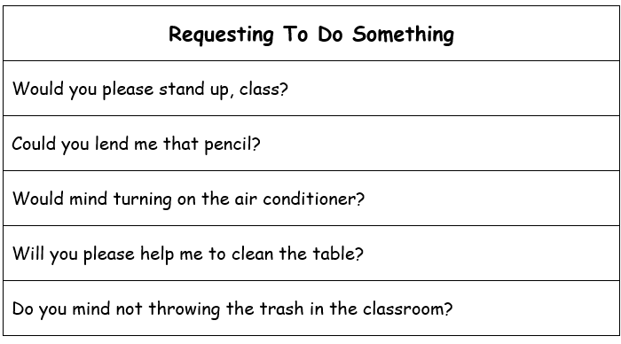

Slide 6
ASKING FOR PERMISSION
May I close the window?
Can I open the door, please?
Do you mind If I sit here?
Is it ok If I use your dictionary?
Please let me go to the restroom, sir?
Permit me to shut down the projector, sir?
May I have your permission to enter the classroom?

